Slide 1
Model Optimization show case

Slide 2
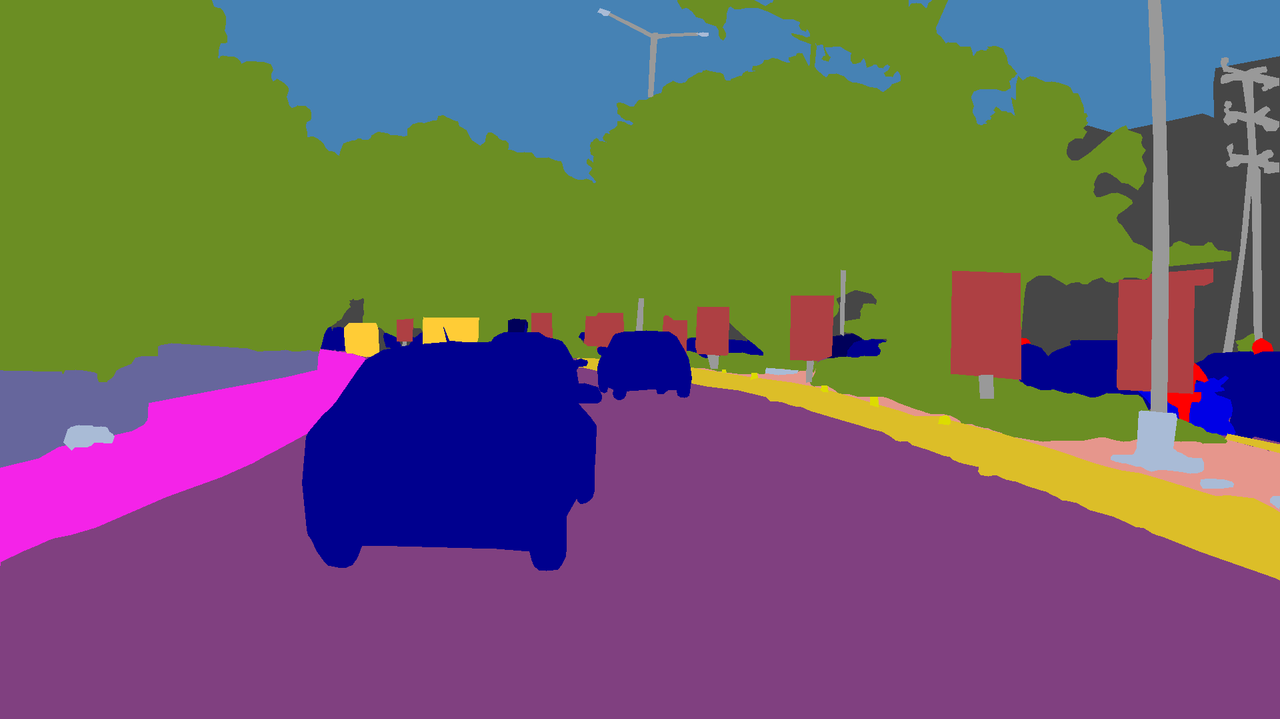
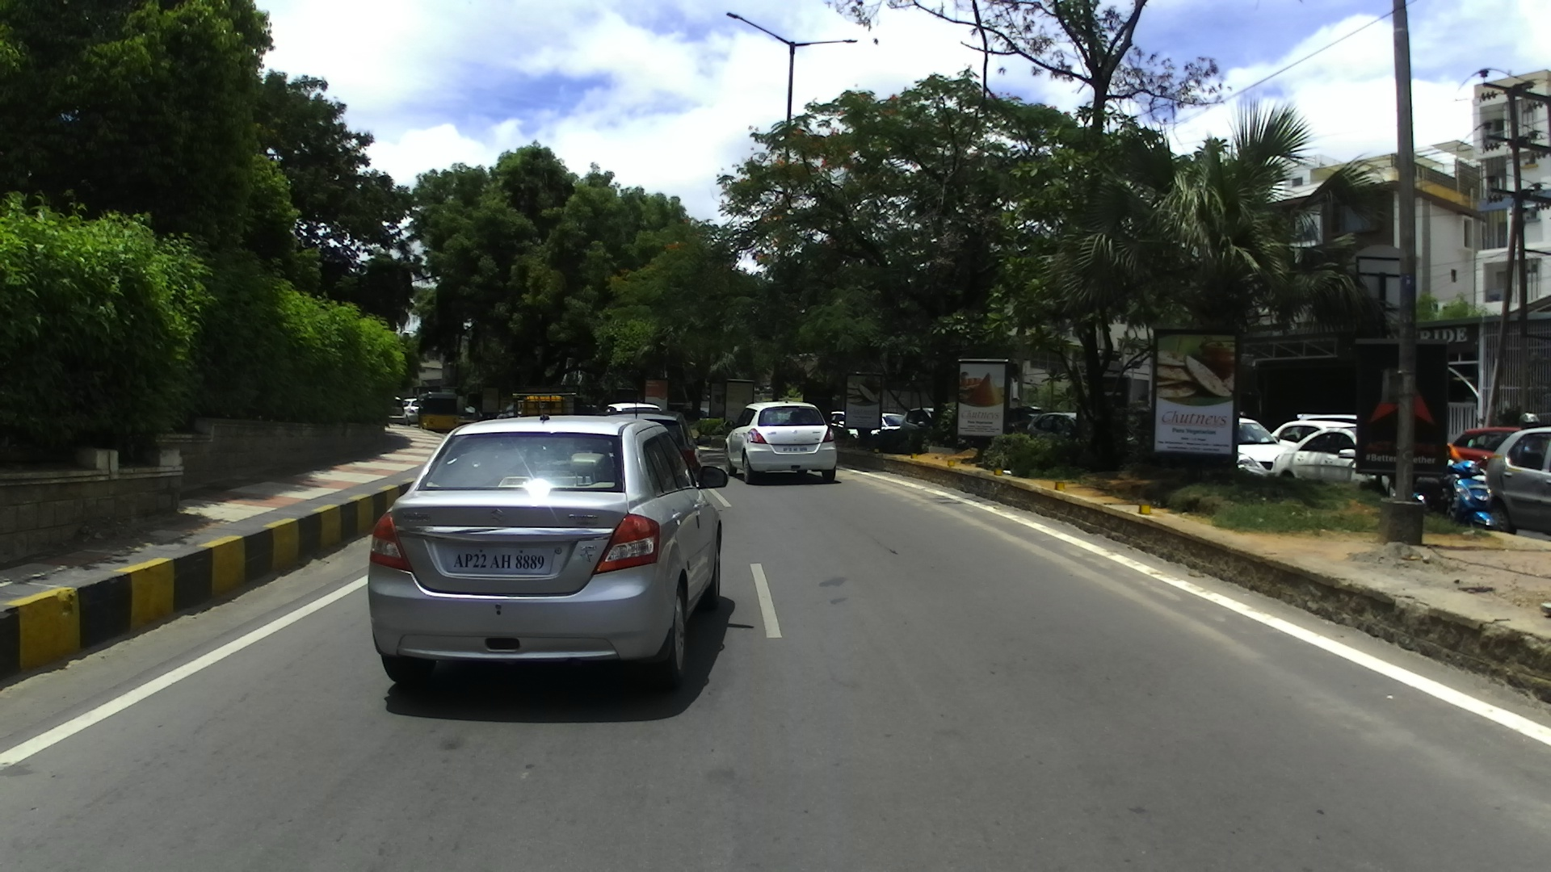
Use case
The problem involves image segmentation using the Cityscapes dataset
It contains 27 distinct classes, which is critical for training algorithms in self-driving car systems, as it helps the vehicle understand and interpret urban environments by segmenting objects like roads, vehicles, pedestrians, and buildings.
Dataset contains 6,000 high-resolution images with a size of 1920x1080 pixels

Slide 3
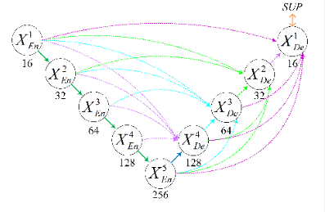
Model Used
The model is Unet with multi scale skip connection , on each layer has attention mechanism to enhance fine grained features detections ,
For the computational resources I used 128x128 image
Model Size : 19,67Mb
Total Parameters : 5,152 M

Slide 4
Model Optimization
Original model
Model size : 78,546 Mb
Image size : 128x128
MFLOPs = 16728,633
Total Parameters : 20,581 M
Inference time : 0,25 s
Model size : 78,546 Mb
Image size : 256x256
MFLOPs = 66914,005
Total Parameters : 20,581 M
Inference time : 0,8 s
Model size : 78,546 Mb
Image size : 512x512
MFLOPs = 267655,491
Total Parameters : 20,581 M
Inference time : 3,2 s
As image size increase , FLOPs increase and inference time increase
For real-time applications, computational efficiency is critical. We prioritize FLOPs (Floating Point Operations) to ensure faster inference times. However, the model must also be complex enough to capture high-level features and maintain accuracy. Balancing complexity and efficiency is key ,excessive complexity increases FLOPs and slows inference, hindering deployment

Slide 5
Model Optimization
Optimized model
Model size : 2,44511 Mb
Image size : 128x128
MFLOPs = 818,687
Total Parameters : 0,64 M
Inference time : 0,1 s
Key Improvements
Model Size: Reduced by 87%, making it more lightweight and easier to deploy.
FLOPs: Reduced by 80%
Parameters: Reduced by 88%.
Inference Time: Reduced by 62%, enabling faster real-time performance.
We haven’t applied any optimization methods yet , think if we applied , how much model can be reduced and make it much lightweight

Slide 6
Key Challenges
Due to limited computational resources, the image size was reduced from 1920x1080 to 128x128. This reduction may result in the loss of many semantic features, as finer details are often compromised at lower resolutions
The dataset contains 27 classes, many of them are underrepresented. This class imbalance can lead to biased model performance, as the model may struggle to learn meaningful features for the minority classes

Slide 7
Proposed solution
Introduced class weights to ensure that each class has equal importance during model training, and model wont biased towards any class
Combined multiple loss functions: Focal Loss, Tversky Loss to address different challenges, such as class imbalance with focus on hard to classify pixels, balances between precision and recall with IOU optimization
Fine tuned the combination by adjusting their weights and hyperparameters to ensures that the model effectively addresses these problems

Slide 8
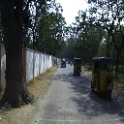
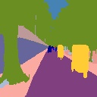


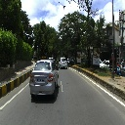

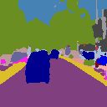
Training results
Original model
GT
Prediction

Slide 9
Training results
Original model Metrics
Class | Dice | IoU | Precision | Recall
class_0 | 0.957 | 0.918 | 0.954 | 0.960
class_1 | 0.414 | 0.261 | 0.761 | 0.284
class_2 | 0.961 | 0.925 | 0.983 | 0.939
class_5 | 0.234 | 0.132 | 0.346 | 0.176
class_6 | 0.362 | 0.221 | 0.950 | 0.224
class_8 | 0.588 | 0.417 | 0.816 | 0.460
class_9 | 0.944 | 0.895 | 0.920 | 0.970
class_12 | 0.333 | 0.200 | 0.250 | 0.500
class_13 | 0.372 | 0.229 | 0.258 | 0.667
class_14 | 0.262 | 0.151 | 0.591 | 0.168
class_17 | 0.021 | 0.011 | 0.143 | 0.011
class_20 | 0.080 | 0.041 | 0.119 | 0.060
class_22 | 0.814 | 0.686 | 0.760 | 0.877
class_24 | 0.943 | 0.892 | 0.967 | 0.920
class_25 | 0.973 | 0.948 | 0.954 | 0.994
Mean | 0.551 | 0.462 | 0.651 | 0.547

Slide 10

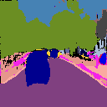
Training results
Optimized model
GT
Prediction

Slide 11
Comparaison
 | Precision | Recall | F1_score | Dice
Original Model | 0,65 | 0,54 | 0,57 | 0,55
Small Model | 0,6 | 0,4 | 0,48 | 0,39
Despite having fewer parameters and neither the small nor the original model being fully trained due to computational constraints, the small model demonstrated the ability to learn efficient features effectively. This highlights the potential of smaller, more resource-efficient models in achieving significant performance even under limitations

Slide 12
Key Concept
The key idea is where a smaller, more efficient model is trained to replicate the behavior of a larger, more complex model by minimizing the probabilities of both logits.
The goal is to transfer the knowledge from complex model to the small model, which typically has fewer parameters but still performs comparably in terms of accuracy.
Big Model
Predictions
MSE loss
Knowledge Loss
Dataset
Predictions
Small Model

Slide 13
Conclusion
For the future work could explore integrating attention mechanisms to further enhance the small model's ability to focus on the most relevant features, potentially improving its performance and efficiency even with limited computational resources. This approach could also help in better understanding and leveraging the relationships within the data, leading to more robust and interpretable models

Slide 14
THANKS
Houssam Eddine Ben Salah​

